Slide 1
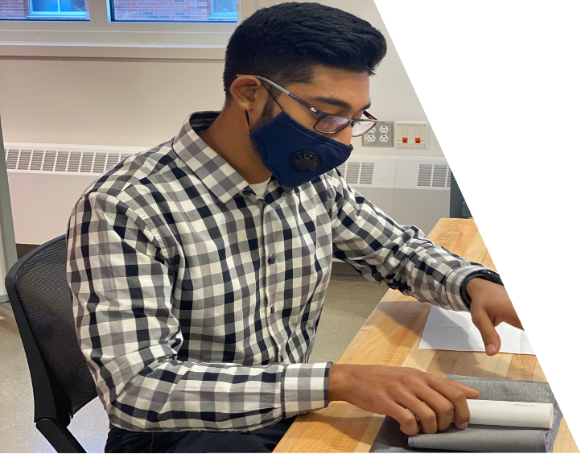
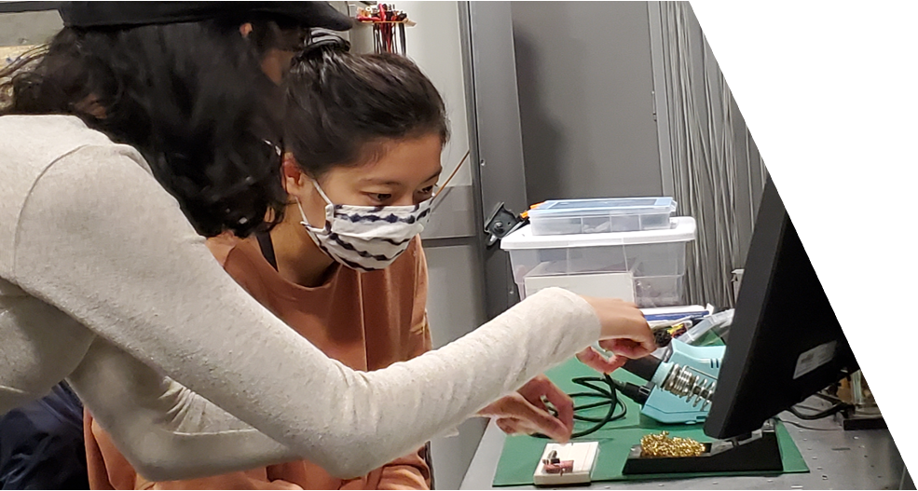
Master of Science
HEALTH TECHNOLOGY
Innovating for Health
EARN YOUR MASTER OF SCIENCE IN ONE YEAR
100% career placement
100% of students received scholarship/fellowship
Targeted applied capstone experience
(Industry, Clinical, Community, Research)
Early Admission deadline is December 1!
Virtual Info Session Wednesdays at 3PM:
ahs.illinois.edu/MSHT
healthtech@illinois.edu

